Slide 1
For Live Session Assignment (FLS)
Unit 2

Slide 2
Question 1: Quick Quiz Questions

Slide 3
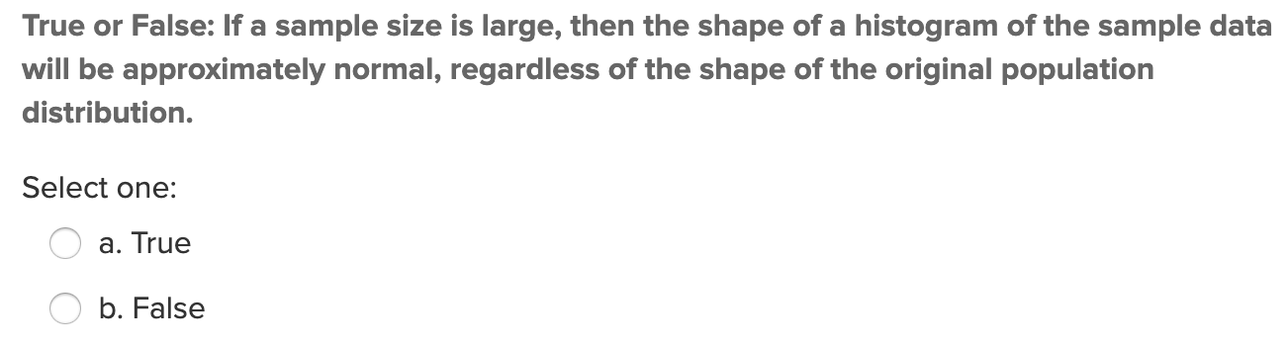
Quick Quiz Question (QQQ 1)

Slide 4
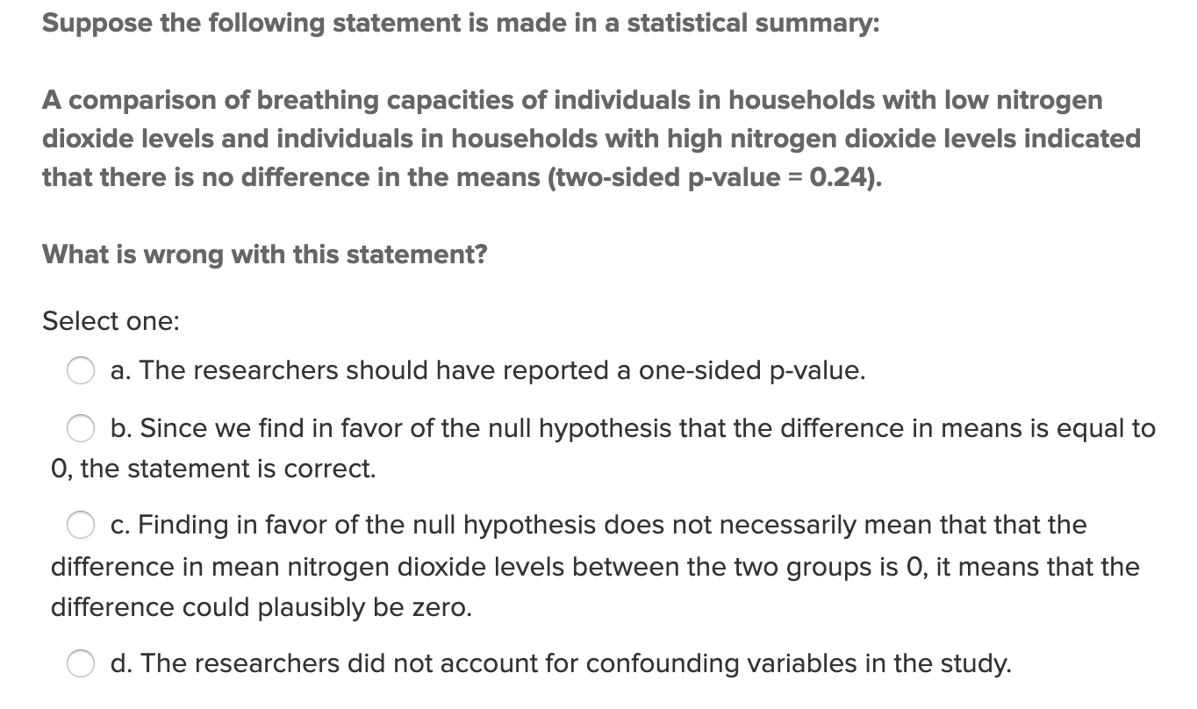
QQQ 2

Slide 5
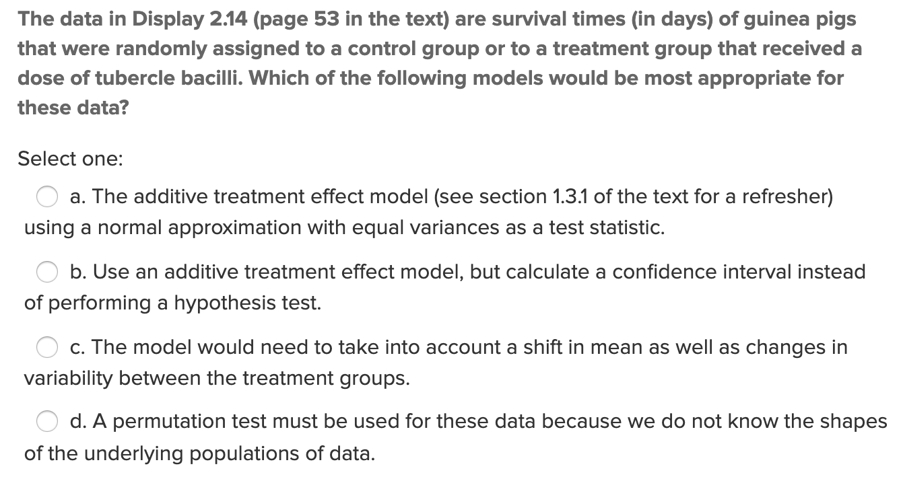
QQQ 3

Slide 6
End Question 1: Quick Quiz Questions

Slide 7

Question 2 ($≤2$ hours)

Slide 8
CLT Activity
Now, take 500 random samples, each of size 5. What is the mean of the 500 means?
What is the range of the 500 sample means(smallest value and largest value)?
What is the standard deviation of the 500 sample means? You can find this value in the upper right corner of the graph on the lower right.
Describe the distribution of 500 sample means from samples of size 5 (think shape, center, and spread).
Run the following simulations using the applet. Click “reset” before each simulation!! For each simulation, obtain the mean and standard deviation of the 500 sample means.
a. Number of samples = 500, sample size = 10
b. Number of samples = 500, sample size = 20
c. Number of samples = 500, samples size = 50
For each of a, b, and c, above, describe the shape of the distribution of the 500 sample means relative to the original population distribution.
For each of a, b, and c, calculate sigma divided by the square root of n and compare this to the standard deviation of the distribution of the sample means from your simulation.

Slide 9
CLT Activity
How do the distributions of simulated samples of the same sample size compare to one another (think center, shape, and spread). These are the samples that you see in the middle histogram.
Describe the distributions of the sample means for samples of size 5, 10, 20, and 50. How do these distributions compare to one another, and to the population distribution?
What would you expect to happen to the distribution of the sample means if we changed the sample size again, to a larger number?
What is the pattern that you see?
Fore Shadowing for the next section: Do you think the same pattern would result if we took samples and made distributions of sampling statistics for other types of populations (not word lengths)? Try it with “Pennies” and “Change”. (Note, the "Variable" needs to be set in the "Show Sampling Options" section.) What do you see?
Do you think the same pattern would result if we took samples and made distributions of other sampling statistics (not the mean)? Try it by punching the radio buttons for the median and standard deviation over the plot at the bottom right.

Slide 10
End Question 2

Slide 11

Question 3 ($≤2$ hours)

Slide 12
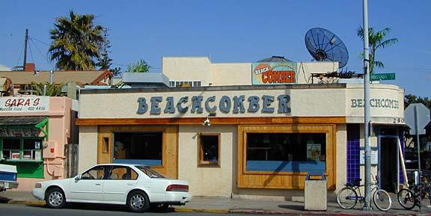
Confidence Interval
The following are ages of 7 randomly selected patrons at the Beach Comber in South Mission Beach at 7pm! We assume that the data come from a normal distribution and would like to construct and interpret a 95% confidence interval for the actual mean age of patrons at the Comber. Assume we don’t know the population standard deviation and have estimated it to be 7.08 years. In addition, the t multiplier (t critical value) for this problem is 2.447. The other statistics needed to construct the interval will need to be derived from the data. Show and fully explain your work.
25, 19, 37, 29, 40, 28, 31

Slide 13
End Question 3

Slide 14

Question 4 ($≤$1 hour)

Slide 15
1 Sample Hypothesis Testing: The 6 Steps
Identify H₀ and H_{a}.
Find the Critical Value(s) and Draw and Shade.
Calculate the Test – Statistic. (The evidence!)
Calculate the p-value.
Make a decision… Reject H₀ or FTR H₀.
Write a clear conclusion in the context of the problem…. Use mostly non-statistical terms but always report the p-value! Add a confidence interval if appropriate. End this conclusion with a statement about the scope.

Slide 16
Example: 1 Sample t-test
The following are ages of 7 randomly chosen patrons seen leaving the Beach Comber in South Mission Beach at 7pm! We assume that the data come from a normal distribution and would like to test the claim that the mean age of the distribution of Comber patrons is different than 21. Conduct a 6 step one sample 2-sided t-test with alpha = .05 to test this claim. Provide enough explanation to fully describe each step. Recall that Step 2 is finding the critical value which is the same as the t multiplier in the corresponding 95% confidence interval.
25, 19, 37, 29, 40, 28, 31

Slide 17
End Question 4

Slide 18

Question 5 ($≤2$ hours)

Slide 19
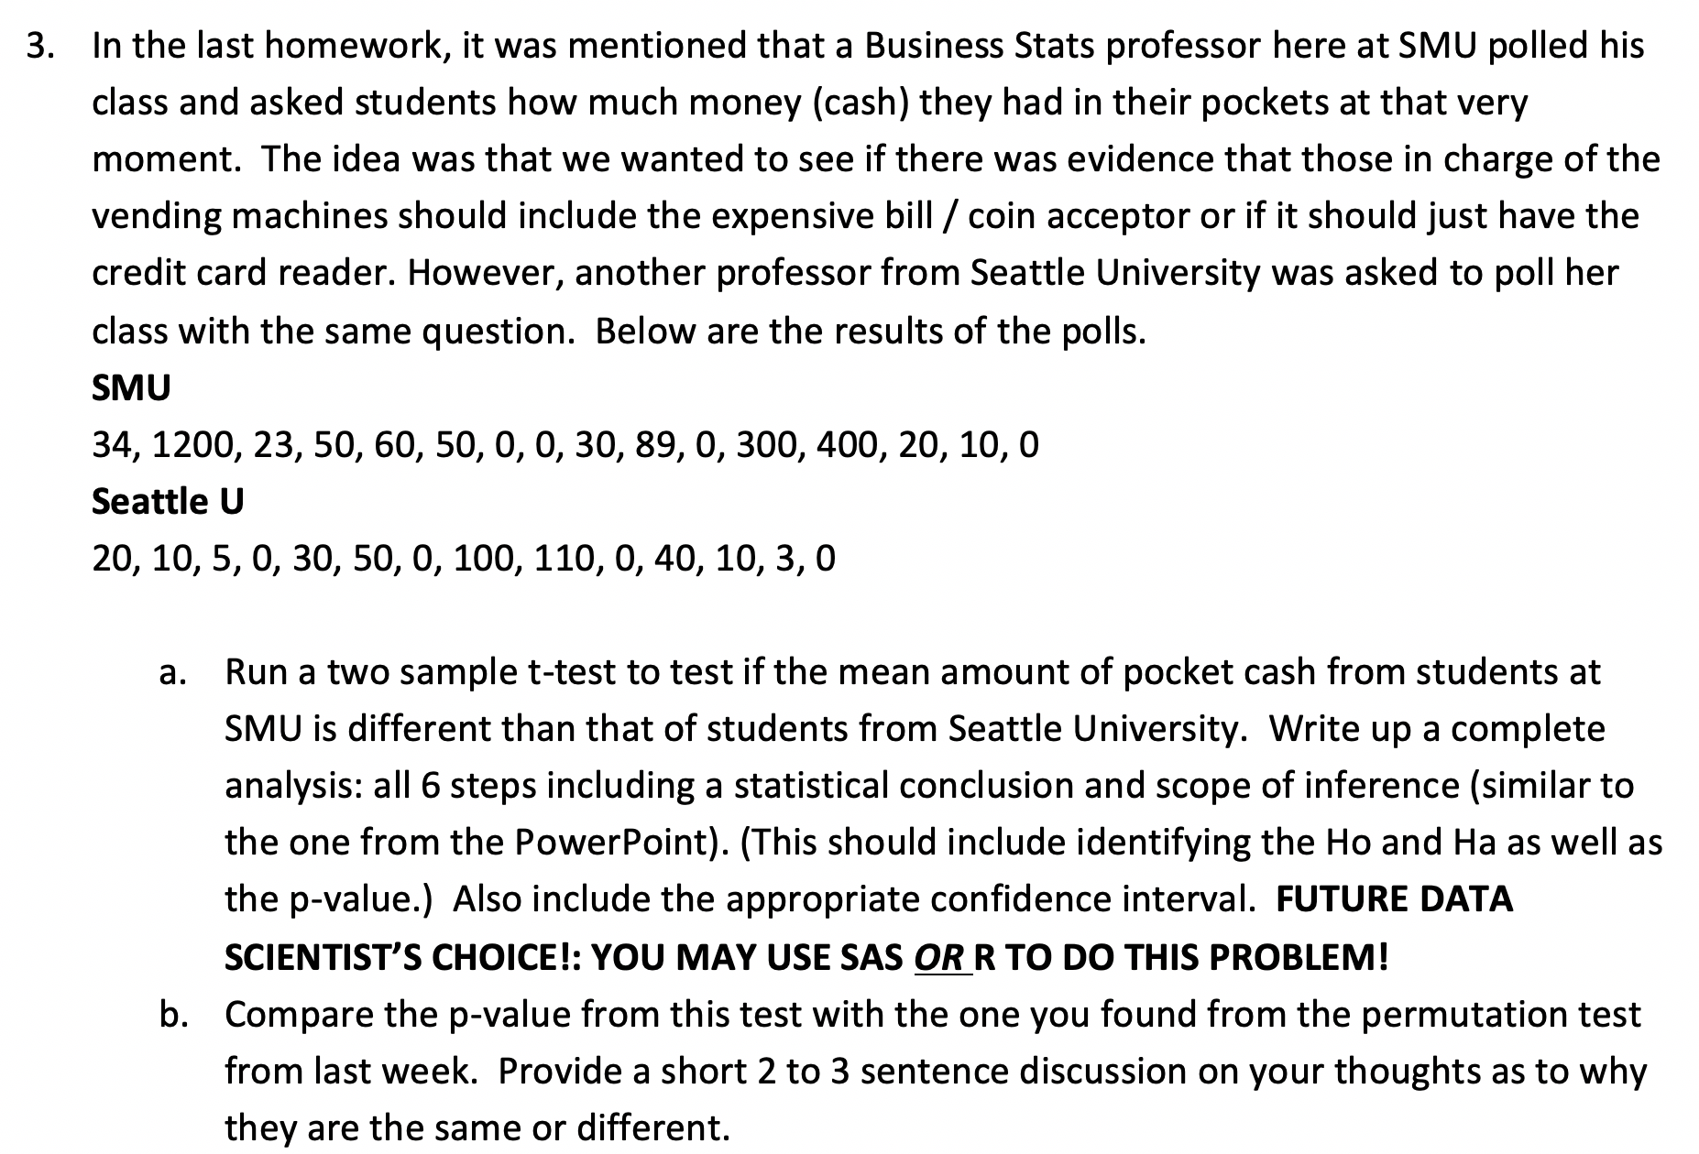
From The Homework! (Q 3)

Slide 20
End Question 5

Slide 21
Question 6: Takeaways! (~ 1 Hour)
Please provide at least 4 takeaways from this section and any questions that you may have. These questions will help design the live session for this unit.
This question will be the last question of every For Live Session Assignment. The idea is that this deck will serve as a document that you can reference in the future to remember what was covered in this section. For instance, this may come in handy for the Capstone and will hopefully become useful in your career. Most immediately, it may become handy as a quick reference for your Midterm and Final! Some students find it very useful and spend a few slides summarizing the asynch material while others learn different ways and only had the minimum 4 takeaways. Either is fine and will earn you full credit for this question.

Slide 22
Question 7: Questions!
Please provide any question or topics of discussion that came up in this Unit! These will help help us optimize our live session for maximum learning and takeaways!
This question will be the last question of every For Live Session Assignment. The idea is that this deck will serve as a document that you can reference in the future to remember what was covered in this section. For instance, this may come in handy for the Capstone and will hopefully become useful in your career. Most immediately, it may become handy as a quick reference for your Midterm and Final! Some students find it very useful and spend a few slides summarizing the asynch material while others learn different ways and only had the minimum 4 takeaways. Either is fine and will earn you full credit for this question.

Slide 23
End For Live Session Assignment Unit 2!

